Slide 1
Multithreading Concepts

Slide 2
What is Multithreading?
A multi-processing OS can run several processes at the same time
Each process has its own address/memory space
The OS's scheduler decides when each process is executed
Only one process is actually executing at any given time. However, the system appears to be running several programs simultaneously
Multithreading is similar to multi-processing.
We can subdivide specific operations within a single application into individual threads
Each of the threads can run in parallel.
OS divides processing time among each thread within an application.

Slide 3
Why Multithreading?
In a single threaded application, one thread of execution must do everything
If an application has several tasks to perform, those tasks will be performed when the thread can get to them.
In a multithreaded application, each task can be performed by a separate thread
If a multithreaded application is being executed on a system that has multiple processors, the OS may execute separate threads simultaneously on separate processors.

Slide 4
What Kind of Applications Use Multithreading?
Any kind of application which has distinct tasks which can be performed independently
Any application with a GUI.
Threads dedicated to the GUI can delegate the processing of user requests to other threads.
The GUI remains responsive to the user even when the user's requests are being processed
Any application which requires asynchronous response
Network based applications are ideally suited to multithreading.
Data can arrive from the network at any time.
In a single threaded system, data is queued until the thread can read the data
In a multithreaded system, a thread can be dedicated to listening for data on the network port
When data arrives, the thread reads it immediately and processes it or delegates its processing to another thread

Slide 5
...Contd
Consider a simple web server
The web server listens for request and serves it
Web server (not multithreaded)
the requests processing would be in a queue, thus increasing the response time and also might hang the server if there was a bad request.
Web server (multithreaded)
web server can serve multiple request simultaneously thus improving response time

Slide 6
How does it all work?
Each thread is given its own "context"
A thread's context includes virtual registers and its own calling stack
The "scheduler" decides which thread executes at any given time
The scheduler maintains a list of ready threads (the run queue) and a list of threads waiting for input (the wait queue)
Each thread has a priority. The scheduler typically schedules between the highest priority threads in the run queue

Slide 7
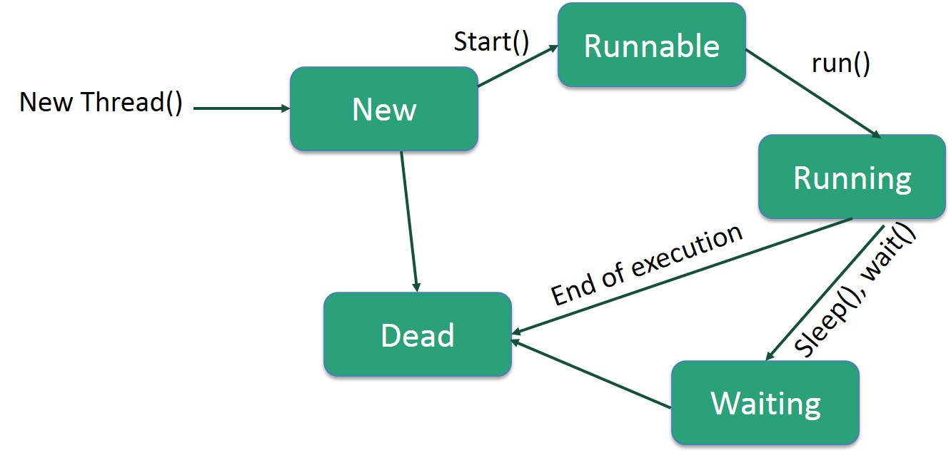
Life cycle of thread

Slide 8
How to create threads?
There are two ways to create a thread:
By extending Thread class
By implementing Runnable interface.

Slide 9

Sample Example1 – Extending Thread
class Thread1 extends Thread
{
public void run()
{
System.out.println("Thread running");
}
}
public class ExThread1
{
public static void main(String args[])
{
Thread1 t=new Thread1();
t.start();
}
}

Slide 10
Sample Example2 – Implementing Runnable Interface
class Thread2 implements Runnable
{
public void run()
{
System.out.println("thread is running...");
}
}
public class ExThread2
{
public static void main(String args[])
{
Thread2 t;
Thread t1 =new Thread(t);
t1.start();
}
}
ExThread2 not extending Thread class
Explicitly create Thread class object.
Pass the object of the class that
implements Runnable interface

Slide 11
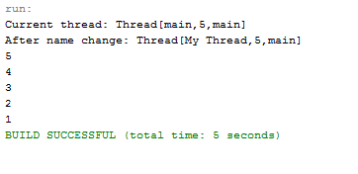
Sample Example3 – Making current program as thread
public class CurrentThreadDemo
{
public static void main(String args[])
{
Thread t = Thread.currentThread();
System.out.println("Current thread: " + t);
// change the name of the thread
t.setName("My Thread");
System.out.println("After name change: " + t);
try {
for(int n = 5; n > 0; n--)
{
System.out.println(n);
Thread.sleep(1000);
}
} catch (InterruptedException e)
{
System.out.println("Main thread interrupted");
}
}
}

Slide 12
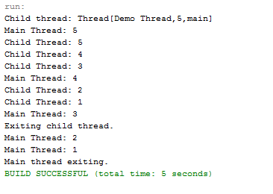
Sample Example4 - Creating Multiple Threads
class NewThread implements Runnable
{
Thread t;
NewThread()
{
t = new Thread(this, "Demo Thread");
System.out.println("Child thread: " + t);
t.start(); // Start the thread
}
public void run()
{
for(int i = 5; i > 0; i--)
{
System.out.println("Child Thread: " + i);
Thread.sleep(500);
}
System.out.println("Exiting ch. thread.");
}
}
class ThreadDemo
{
public static void main(String args[])
{
new NewThread();
for(int i = 5; i > 0; i--)
{
System.out.println("Main Thread: " + i);
Thread.sleep(1000);
}
System.out.println("Main thread exiting.");
}
}

Slide 13
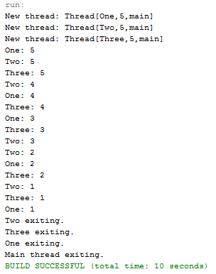
Sample Example4 – Multiple threads – Make main thread to wait
class Threads implements Runnable
{
String name; // name of thread
Thread t;
Threads(String threadname) {
name = threadname;
t = new Thread(this, name);
System.out.println("New thread: " + t);
t.start(); // Start the thread
}
public void run() {
try {
for(int i = 5; i > 0; i--) {
System.out.println(name + ": " + i);
Thread.sleep(1000);
}
} catch (InterruptedException e) {
System.out.println(name + "Interrupted");
}
System.out.println(name + " exiting.");
}
}
class ExThreeThreads {
public static void main(String args[])
{
new Threads("One"); // start threads
new Threads("Two");
new Threads("Three");
try {
// wait for other threads to end
Thread.sleep(10000);
} catch (InterruptedException e) {
System.out.println("Main thread Interrupted");
}
System.out.println("Main thread exiting.");
}
}

Slide 14
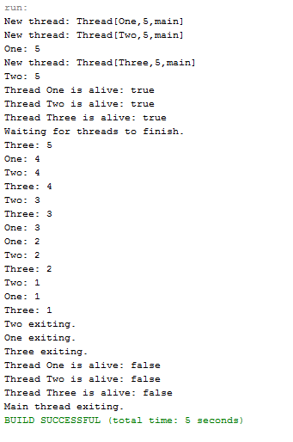
Example5 – Improved Version
Main thread starts the t1 and t2 threads.
Two threads start running in parallel.
The main thread calls t1.join() to wait
for the t1 thread to finish.
The t1 thread completes
and the t1.join() method returns.
The main thread calls t2.join() to wait
for the t2 thread to finish.
public class ExThreeThreadsImproved
{
public static void main(String args[])
{
Threads1 ob1 = new Threads1("One");
Threads1 ob2 = new Threads1("Two");
Threads1 ob3 = new Threads1("Three");
System.out.println("Thread One is alive: “ + ob1.t.isAlive());
System.out.println("Thread Two is alive: “ + ob2.t.isAlive());
System.out.println("Thread Three is alive: “ + ob3.t.isAlive());
System.out.println("Waiting for threads to finish.");
ob1.t.join();
ob2.t.join();
ob3.t.join();
System.out.println("Thread One is alive: "
+ ob1.t.isAlive());
System.out.println("Thread Two is alive: "
+ ob2.t.isAlive());
System.out.println("Thread Three is alive: "
+ ob3.t.isAlive());
System.out.println("Main thread exiting.");
}
}
class Threads1 implements Runnable {
String name; // name of thread
Thread t;
Threads1(String threadname) {
name = threadname;
t = new Thread(this, name);
System.out.println("New thread: " + t);
t.start(); // Start the thread
}
// This is the entry point for thread.
public void run() {
try {
for(int i = 5; i > 0; i--) {
System.out.println(name + ": " + i);
Thread.sleep(1000);
}
} catch (InterruptedException e) {
System.out.println(name + " interrupted.");
}
System.out.println(name + " exiting.");
}
}

Slide 15
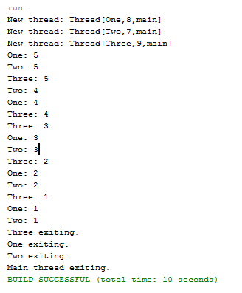
Example6 – Thread Priorities
class Thread3 implements Runnable
{
String name; // name of thread
Thread t;
Thread3() { }
Thread3(String threadname, int p)
{
name = threadname;
t = new Thread(this, name);
t.setPriority(p);
System.out.println("New thread: " + t);
t.start(); // Start the thread
}
public void run()
{
for(int i = 5; i > 0; i--)
{
System.out.println(name + ": " + i);
Thread.sleep(1000);
}
System.out.println(name + " exiting.");
}
}
public class ThreadPriority {
public static void main(String args[])
{
Thread3 ob1 = new Thread3("One",8);
Thread3 ob2 = new Thread3("Two",7);
Thread3 ob3 = new Thread3("Three",9);
try {
// wait for other threads to end
Thread.sleep(10000);
} catch (InterruptedException e) {
System.out.println("Main thread Interrupted");
}
System.out.println("Main thread exiting.");
}
}

